Slide 1

Exam Score Prediction Dataset
Srijan Kattel | Prashant Puri | Abhinav Man Shrestha

Slide 2
Problem Statement
“ Students often struggle to achieve their potential due to varying study habits and lifestyle factors, creating a need for predictive insights into exam performance. “

Slide 3
Dataset from Kaggle
Unique student ID
Demographic details (age, gender, course)
Study habits (daily study hours, attendance)
Lifestyle factors (sleep duration, sleep quality)
Resource access (internet availability)
Academic environment (facility rating)
Exam difficulty level
Final exam score (0–100)

Slide 4
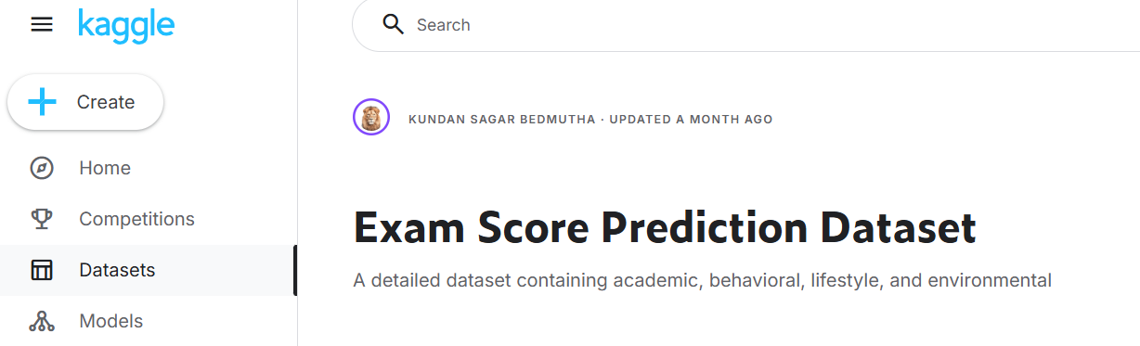
Dataset
The dataset has about 20,000 records, each describing a student’s academic behavior, study habits, lifestyle routines, and exam conditions

Slide 5
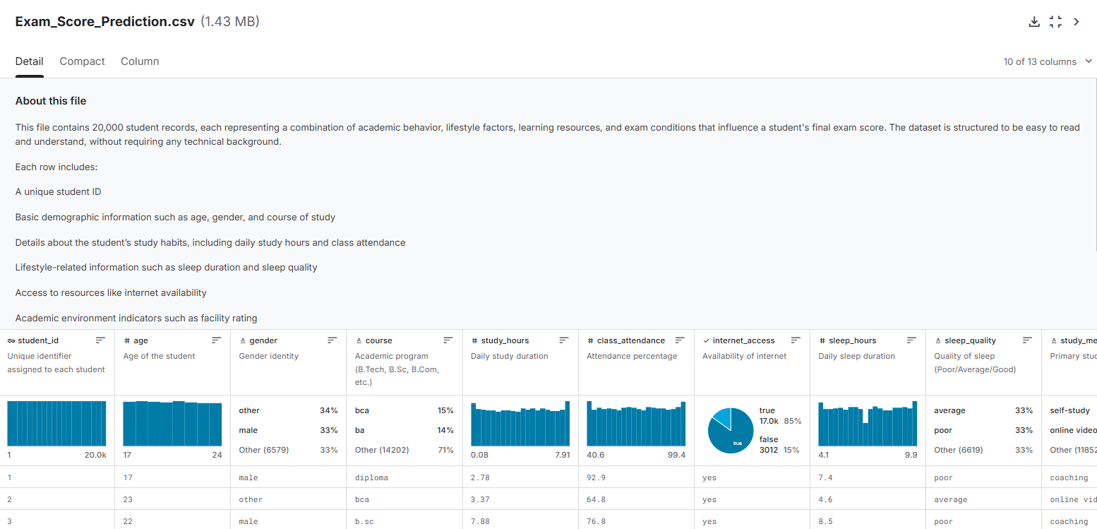

Slide 6
What we will focus on
Clean and structure the dataset ( EDA)
Apply statistical analysis (Linear Regression, ANOVA, Logistic Regression)
Develop a simple end-to-end application on Python
Generate a report documenting methods, insights, and conclusions

Slide 7



